Slide 1

Module 6: Architectural Design
Part IV
Software Engineering
School of Computing, Faculty of Engineering
Universiti Teknologi Malaysia

Slide 2
Architectural pattern
Model-View-Controller (MVC), Layered, Repository, Client-Server, Pipe and Filter

Slide 3
Architectural Patterns
Patterns (also known as styles) are a means of representing, sharing and reusing knowledge
An architectural pattern is a stylized description of good design practice, which has been tried and tested in different environments
Patterns should include information about when they are and when they are not useful
Patterns may be represented using tabular and graphical descriptions

Slide 4
Common Architectural Patterns
Model-View-Controller (MVC)
Layered
Repository
Client-Server
Pipe and Filter

Slide 5
Model-View-Controller (MVC) Pattern
Name | MVC (Model-View-Controller)
Description | Separates presentation and interaction from the system data. The system is structured into three logical components that interact with each other. The Model component manages the system data and associated operations on that data. The View component defines and manages how the data is presented to the user. The Controller component manages user interaction (e.g., key presses, mouse clicks, etc.) and passes these interactions to the View and the Model.
Example | The architecture of a web-based application system organized using the MVC pattern (see the example slide).
When used | Used when there are multiple ways to view and interact with data. Also used when the future requirements for interaction and presentation of data are unknown.
Advantages | Allows the data to change independently of its representation and vice versa. Supports presentation of the same data in different ways with changes made in one representation shown in all of them.
Disadvantages | Can involve additional code and code complexity when the data model and interactions are simple.

Slide 6
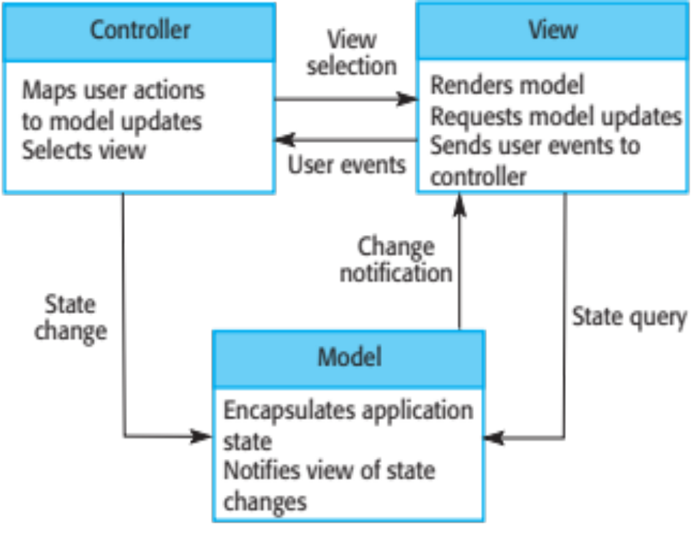
Organization of MVC

Slide 7
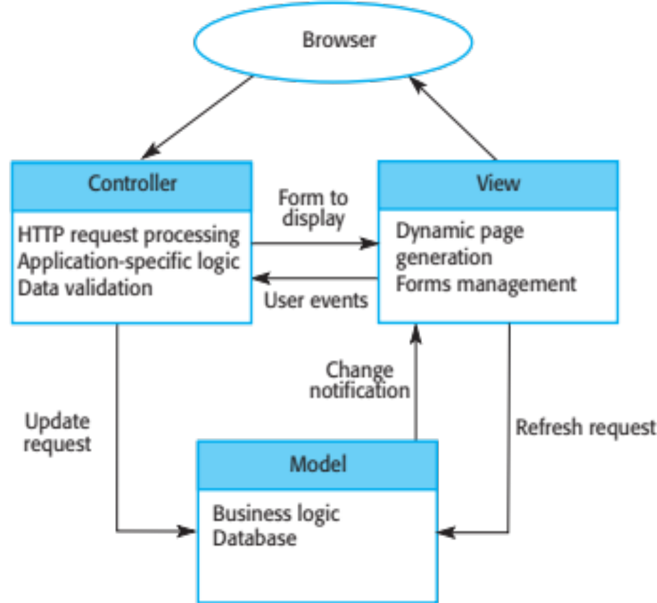
Web Application Architecture Using MVC

Slide 8
Layered Architecture
Used to model the interfacing of sub-systems
Organises the system into a set of layers (or abstract machines) each of which provide a set of services
Supports the incremental development of sub-systems in different layers
When a layer interface changes, only the adjacent layer is affected
As layered systems localize machine dependencies, this makes it easier to provide multi-platform implementations of an application system

Slide 9
Layered Architecture Pattern
Name | Layered architecture
Description | Organizes the system into layers with related functionality associated with each layer. A layer provides services to the layer above it so the lowest-level layers represent core services that are likely to be used throughout the system. See next slide.
Example | A layered model of a system for sharing copyright documents held in different libraries, as shown in the iLearn example slide.
When used | Used when building new facilities on top of existing systems; when the development is spread across several teams with each team responsibility for a layer of functionality; when there is a requirement for multi-level security.
Advantages | Allows replacement of entire layers so long as the interface is maintained. Redundant facilities (e.g., authentication) can be provided in each layer to increase the dependability of the system.
Disadvantages | In practice, providing a clean separation between layers is often difficult and a high-level layer may have to interact directly with lower-level layers rather than through the layer immediately below it. Performance can be a problem because of multiple levels of interpretation of a service request as it is processed at each layer.

Slide 10
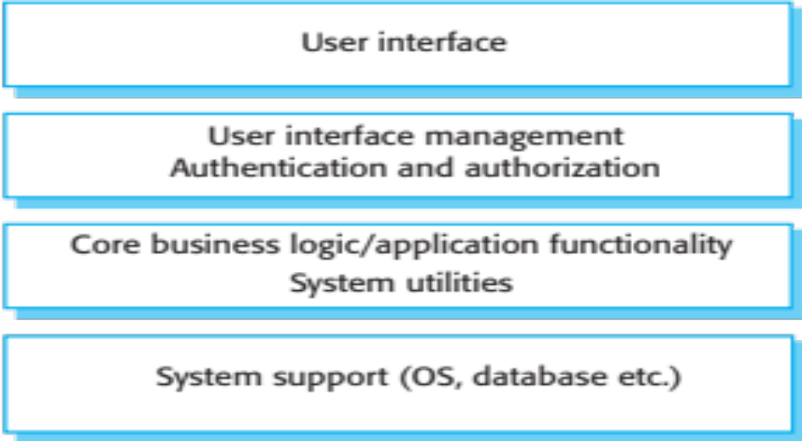
Generic Layered Architecture

Slide 11
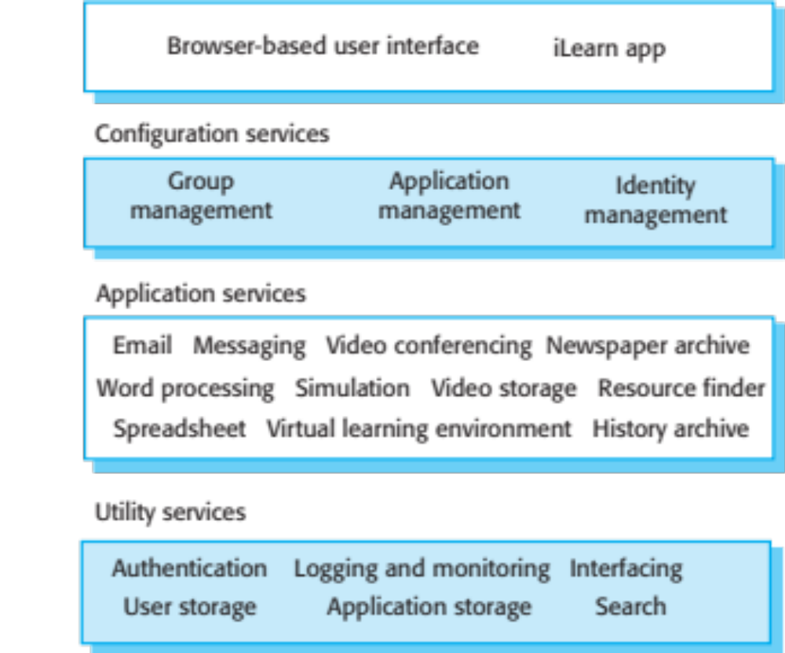
Example: Architecture of iLearn System

Slide 12
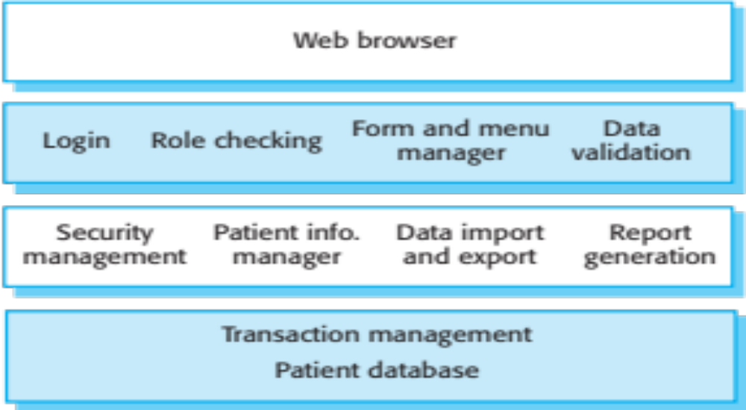
Example: Architecture of Mentcare System

Slide 13
Three and Four Layer Architectures
Presentation
Presentation
Business logic layer can be split into 2 layers
Application logic
Business logic
Domain
Database
Database
Source: Bennett, McRobb and Farmer (2010)

Slide 14
Example: Partitioned Subsystems in Four Layer Architecture
Loosely coupled subsystems, each delivering a single service or coherent group of services
Presentation
layer
Advert
HCI Subsystem
Campaign Costs
HCI Subsystem
E.g. Agate campaign management system
Application
layer
Advert
Subsystem
Campaign Costs
Subsystem
Campaign Domain
A single domain
layer supports
two application
subsystems
Campaign Database
Source: Bennett, McRobb and Farmer (2010)

Slide 15
Repository Architecture
Sub-systems must exchange data that may be done in two ways:
  Shared data is held in a central database or repository and may be accessed by all sub-systems
  Each sub-system maintains its own database and passes data explicitly to other sub-systems
When large amounts of data are to be shared, the repository model of sharing is most commonly used a this is an efficient data sharing mechanism

Slide 16
Repository Pattern
Name | Repository
Description | All data in a system is managed in a central repository that is accessible to all system components. Components do not interact directly, only through the repository.
Example | An example of an IDE (see next slide) where the components use a repository of system design information. Each software tool generates information which is then available for use by other tools.
When used | Should use this pattern when we have a system in which large volumes of information are generated that has to be stored for a long time. May also use it in data-driven systems where the inclusion of data in the repository triggers an action or tool.
Advantages | Components can be independent—they do not need to know of the existence of other components. Changes made by one component can be propagated to all components. All data can be managed consistently (e.g., backups done at the same time) as it is all in one place.
Disadvantages | The repository is a single point of failure so problems in the repository affect the whole system. May be inefficiencies in organizing all communication through the repository. Distributing the repository across several computers may be difficult.

Slide 17
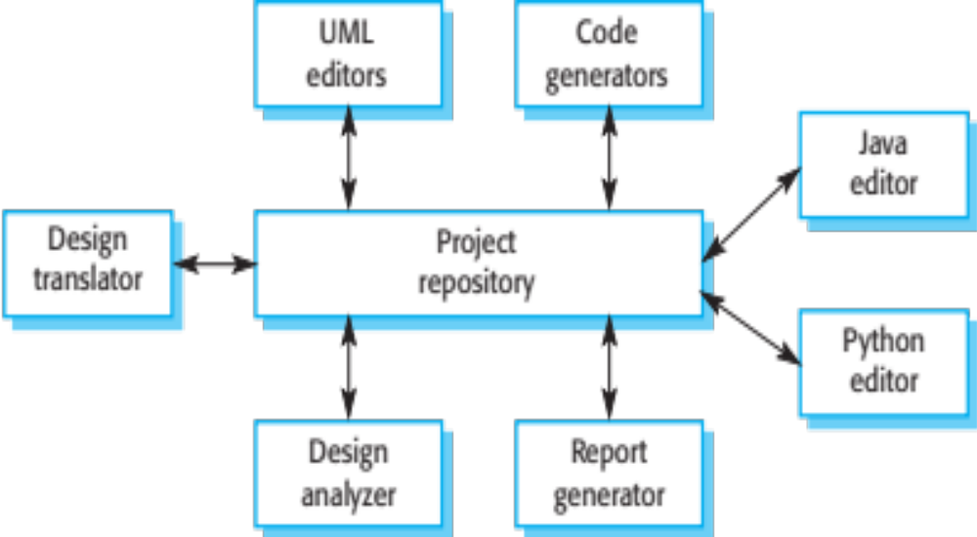
Example: Repository Architecture for an IDE

Slide 18
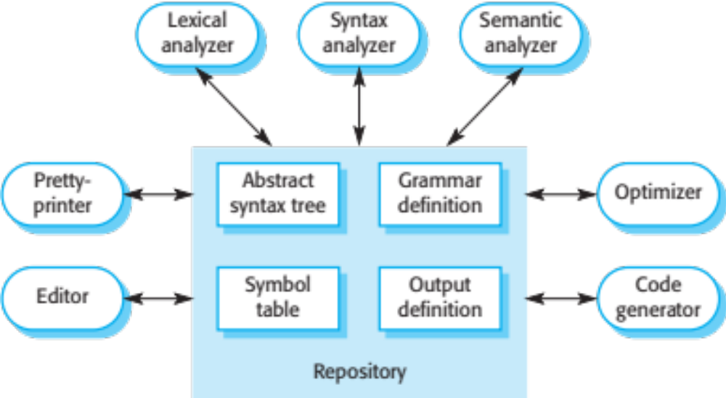
Example: Repository Architecture for Language Processing System

Slide 19
Client-Server Architecture
Distributed system model which shows how data and processing is distributed across a range of components
  Can be implemented on a single computer
Set of stand-alone servers which provide specific services such as printing, data management, etc.
Set of clients which call on these services
Network which allows clients to access servers

Slide 20
Client-Server Pattern
Name | Client-server
Description | In a client–server architecture, the functionality of the system is organized into services, with each service delivered from a separate server. Clients are users of these services and access servers to make use of them.
Example | Example of a film and video/DVD library organized as a client–server system (see next slide).
When used | Used when data in a shared database has to be accessed from a range of locations. Because servers can be replicated, may also be used when the load on a system is variable.
Advantages | The principal advantage of this model is that servers can be distributed across a network. General functionality (e.g. a printing service) can be available to all clients and does not need to be implemented by all services.
Disadvantages | Each service is a single point of failure so susceptible to denial of service attacks or server failure. Performance may be unpredictable because it depends on the network as well as the system. May be management problems if servers are owned by different organizations.

Slide 21
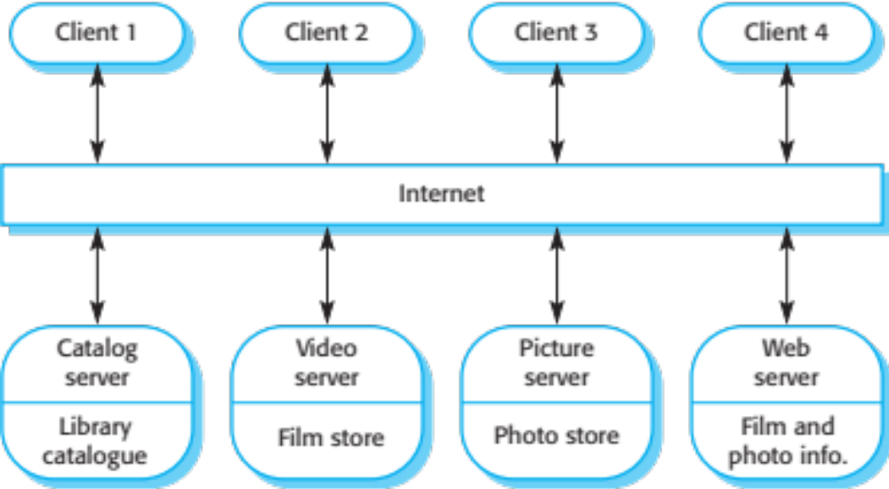
Example: Client-Server Architecture for Film Library

Slide 22
Pipe and Filter Architecture
Functional transformations process their inputs to produce outputs
May be referred to as a pipe and filter model (as in UNIX shell)
Variants of this approach are very common
When transformations are sequential, this is a batch sequential model which is extensively used in data processing systems
Not really suitable for interactive systems

Slide 23
Pipe and Filter Pattern
Name | Pipe and filter
Description | The processing of the data in a system is organized so that each processing component (filter) is discrete and carries out one type of data transformation. The data flows (as in a pipe) from one component to another for processing.
Example | Example of a pipe and filter system used for processing invoices (see next slide).
When used | Commonly used in data processing applications (both batch- and transaction-based) where inputs are processed in separate stages to generate related outputs.
Advantages | Easy to understand and supports transformation reuse. Workflow style matches the structure of many business processes. Evolution by adding transformations is straightforward. Can be implemented as either a sequential or concurrent system.
Disadvantages | The format for data transfer has to be agreed upon between communicating transformations. Each transformation must parse its input and unparse its output to the agreed form. This increases system overhead and may mean that it is impossible to reuse functional transformations that use incompatible data structures.

Slide 24
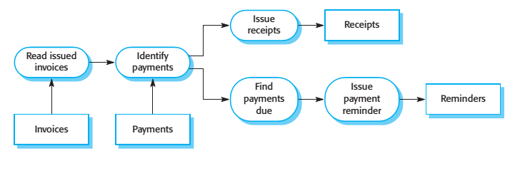
Example: Pipe and Filter Architecture Used in Payments System

Slide 25
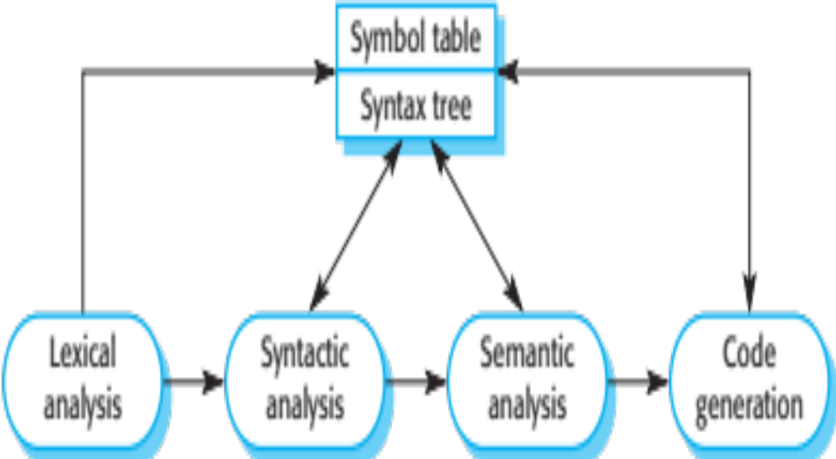
Example: Pipe and Filter Used for Compiler Architecture

Slide 26
Key Points
A software architecture is a description of how a software system is organized.
Architectural design decisions include decisions on the type of application, the distribution of the system, the architectural styles to be used.
Architectures may be documented from several different perspectives or views such as a conceptual view, a logical view, a process view, and a development view.
Architectural patterns are a means of reusing knowledge about generic system architectures. They describe the architecture, explain when it may be used and describe its advantages and disadvantages.

